Slide 1

Untitled Help Desk Application (UHDA)
Group: Untitled
Created by: Gregory Pohlod, Jacob Pauls, and Michael Wilson
CSIS 3275 – Fall 2020
https://github.com/jacob-pauls/Untitled_UHDA_Project
Notes:
Along with all of the individual work on each of our own features,
I - Greg – Project lead, lead meetings, kept minutes, ensured team stayed on task.
Jacob – was the lead on our release management and ensuring all features merged successfully, along with researching how to deploy our slack integrations.
Michael – Michael’s focus on our UI helped us deploy not only a functional tool but a tool that had a great look and feel.

Slide 2
Goals, Metrics, and Measurements
Iteration #1 – Build solid foundation for fundamental user operations
Iteration #2 – Create and design ticketing infrastructure
Iteration #3 – Communication and notification design
Iteration #4 – Developing the UHDA for scalability and maintainability
Notes:
Iteration #1 focused purely on the groundwork and ensuring users can create accounts, reset passwords, log in, log out, and that the admins had full control of these users.
Iteration 2 – focus was on the tickets themselves and developing what the core of our help desk app is, and which many other sections continue to build off of.
Iteration 3 main focus was to continue expanding on the ticketing system which includes communications and notifications by adding commenting, and slack integration to the tool
Iteration 4 is focused on a 5 week sprint to correct any issues, and deploy additional items for scalability and maintainability of the app long term.

Slide 3
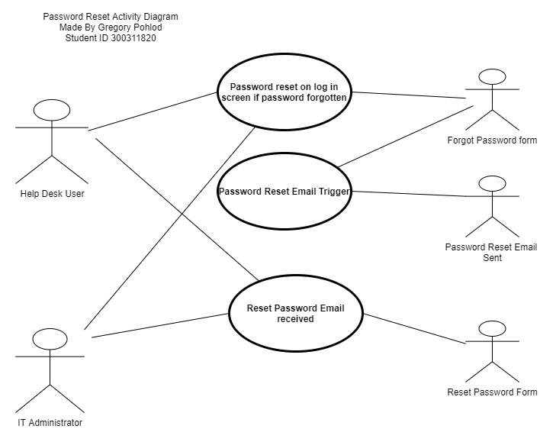
Use Case Highlight #1: Password Reset/Email Notification Integration
UHDA needs password reset functionality for its users.
Utilize Password Reset Emails.
Emails Contain required link/reset token.
Email Notification Feature reusability.
Notes:
A key feature to ensure secure password reset is utilizing the users email on their account to ensure the user is the one that receives the reset email link.
Reset links contain unique random reset tokens that can only be used to reset a password once.
Email notifications were later integrated into ticket actions, and can continue to be rolled out to encompass all steps within the help desk ticketing system
**Then show clicking on forgot password. Getting the reset link (show email) and discuss how this email process was integrated into other ticket actions and will be further integrated in all actions within the tool.

Slide 4
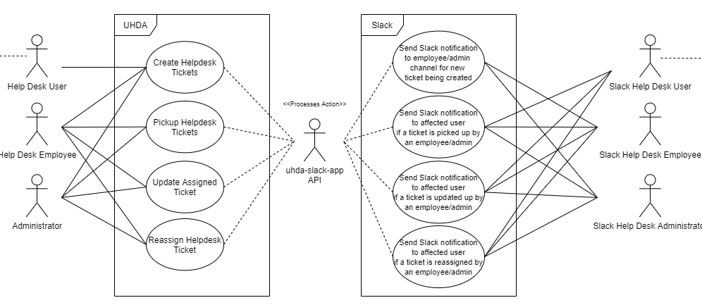

Use Case Highlight #2: Slack Integration
UHDA seeks to associate users with Slack upon login
Slack notifications can be triggered by picking up, creating, or modifying a ticket
https://github.com/jacob-pauls/uhda-slack-app
https://join.slack.com/t/uhdaworkspace/shared_invite/zt-jc3phng5-JFoEymiCxrP44YFPFIqR3Q
Notes:
- Built out as a git submodule (repo located at the link above)
- Detail the Slack integration's ability to connect user's to the uhda (demo a failed use and a successful user)
- Make a change to an owned ticket (by a user associated with Slack)
- Explain the other features (ie: employee users receive notifications to private employee Slack channel)

Slide 5

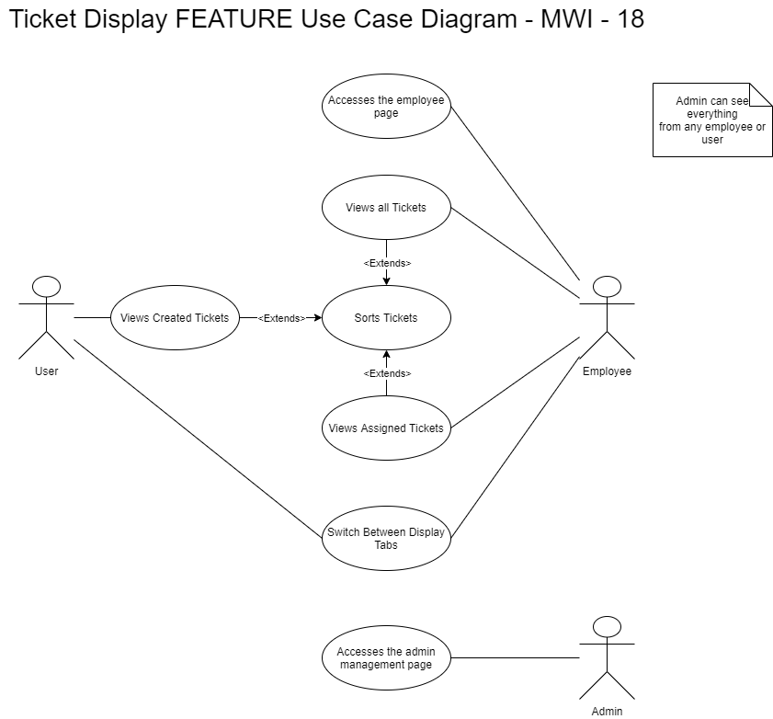
Use Case Highlight #3:Ticketing display
UHDA offers a professional GUI for ticket display
Users can view their tickets
Employees can view all tickets with ought an assignee
Employees can view tickets they have been assigned
Users can sort tickets by various categories
Notes:
The ticketing display is used by all users in the UHDA. It offers multiple ways to sort and view tickets and is easy to understand. With the right authorization, employees and admins have access to the employee home page. This display while very similar to the user homepage, offers the ability for the employees to view unassigned tickets that are available for pickup. When picked up the employees tickets appear in their own tab so they can monitor and work on tickets. The ticket modal view can be opened by clicking open on the tickets.

Slide 6
Project Planning And Issues
Kanban: https://github.com/jacob-pauls/Untitled_UHDA_Project/projects/1
This tool was useful for managing responsibilities of group members, tracking progress, and ensuring deadlines were met.
A project management tool like this is very important to ensure the project moves along at the right pace
We also tied in a webhook for discord so we got updates right to our discord server, we found this worked great for our group. Overall this was a helpful tool for us to stay on track.
The only issues we ran into primarily was in merging our enhancements when the enhancements touched similar areas of the webapp
Notes:
Show our Kanban board, talk about it a bit and show the discord channel. Answers to his questions above.

Slide 7
Testing And Tooling
Utilized Spring Boot and its libraries for the backend
Spring Security
Spring Mail
Frontend consists of jsp files and jQuery, the application is strapped using the UIKit framework
Slack integration is built using Python, Flask, gunicorn, and Heroku
ngrok was used for local testing

Slide 8
Group Participation / Working In Groups
Group Member | Mark* See ppt notes, or listen to video for reasoning
Gregory Pohlod | 9/10
Jacob Pauls | 9.5/10
Michael Wilson | 9.5/10
Our group worked very well together
Learned that managing a team requires understanding of individual strengths and how they fit in together.
Group was the perfect size, we had enough team members to ensure everything got finished, but no so large that it was difficult to keep everyone on task.
Our group communication was excellent and we utilized discord to make this happen. Our main issues arose when filming the project videos as it was difficult to have good flow with all of us in different locations.
Notes:
- Group marks were assigned with the rational the our entire group worked very well together and we were able to meet all of our deliverables in the required time frame.
- The only full mark deducted was from Greg (myself) as both Michael and Jacob put in a ton of time to retool our UI and make it look great, along with the crazy amount of work Jacob put into making the slack integration function.
- With that in mind, Greg felt like he deserved a slightly lower group participation total than his other two group members.

Slide 9
Lessons Learned
6. Manage Change (process guide) - even in a small setting, being able to quickly make roadmap adjustments or feature adjustments based on feedback was vital
3. Be ready to adapt (process guide) - anything and everything can go wrong at any time. By being able to modify our plans helped us overcome obstacles and find new solutions to problems
1. Divide and conquer (practice guide) - multiple small problems are always easier than one giant problem.
2. Face-to-face communication is best (communication principles) - with Covid-19, face-to-face is not a good method. However, tools such as GitHub and discord make communication better than in person.
For this principle I would agree face to face is beneficial, we just had to change how it works.
Notes:
3 Things Learned:
- Sometimes even the nittiest, grittiest, details have to be let go in order to meet deadlines
- Overly abstracting things early on is sometimes less maintainable then getting a working prototype first, and abstracting the results later (ex: Helpdesk Administrator, Helpdesk Employee extension classes that just got deprecated)
- Communicate often and well, it makes dealing with bugs or issues much easier
3 Challenges:
- Face to face communication is best
- (connects to first point but..) lack of time or ability to build rapport with other group members means a slow start for action items regarding trust, accountability, etc.
- Having a large project at first is scary, divide and conquer makes dealing with complex tasks easier

Slide 10
Course Relevancy And Improvement
Suggestions:
Incorporate testing for Spring earlier in the course
Cover best practices for building views with blackbox testing in mind (ie. What you can do to ensure selenium can find different elements and fields consistently).
More hands-on activities during class to practice new concepts
Advice:
Abuse the project: Apply it to something you're interested in or would like to learn
Work ahead: Just because a due date gets extended, don’t slow down your own work… it’s better to stay ahead.
Communicate: Talk to your team and find solutions to problems as they arise
Notes:
Each discuss their own suggestion and advise.
Order Jacob, Greg, Michael,
Michael to sign off

